Slide 1
Logoscope
Women’s hackathon practice problem
7/02/2025

Slide 2
Problem Overview
In a high-tech lab, a powerful inspection tool scans devices and generates detailed log files. These logs contain a mix of messages—
routine INFO, cautionary WARN, and critical ERRORs.
But these logs aren’t always clean. They may include inconsistencies, or missing data. Alongside the logs, an instruction file—the Commands File—is provided. It contains a sequence of operations like REPLACE, INSERT, and DELETE.
The challenge? Build a solution that transforms raw, noisy logs into clean, structured data using the instructions provided.

Slide 3








LOG FILE
CMD FILE
INFO
REPLACE
WARN
INSERT
ERROR
DELETE
YOU!
LOG FILE
INFO
WARN
Processed log file
ERROR

Slide 4
Command Formats
REPLACE: Replace the content at the given line number, but retain the original timestamp from the log file. REPLACE <line_number> "<new_log_content>“ Eg - REPLACE 5 “INFO User login: user123”
INSERT: Insert the new log line in the correct position based on its timestamp.
INSERT "<full_log_line_with_timestamp>“ Eg - INSERT “2025-05-25T10:17:55 INFO User logout: user123”
DELETE: Delete the log line at the specified line number. DELETE <line_number> Eg - DELETE 54

Slide 5
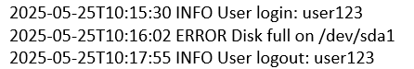
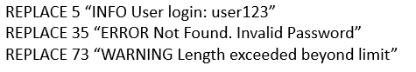
Milestone #1
Input:
M1_LogFile.txt
M1_CommandFile.txt
Output:
Generate the below 2 output files.
Step 1 – M1_ProcessedLogFile.txt - Apply the commands from the given M1_CommndFile on the M1_LogFile and generate the M1_ProcessedLogFile.
Step 2 – M1_Output.txt - Count and report the number of INFO, ERROR, and WARN logs from the M1_ProcessedLogFile.txt
Output format for M1_Output.txt:
INFO: X
ERROR: Y
WARN: Z

Slide 6
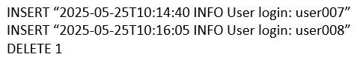
Milestone #2
Input:
M2_LogFile.txt
M2_CommandFile.txt
Note - Please consider the M1_ProcessedLogFile.txt as M2_LogFile.txt Output:
Generate the below 2 output files.
Step 1 – M2_ProcessedLogFile.txt - Apply the commands from the given M2_CommandFile on the M2_LogFile and generate the M2_ProcessedLogFile.
Step 2 – M2_Output.txt - Find the unique users and their login counts from the M2_ProcessedLogFile.txt.
Output Format for M2_Output.txt:
User Login Counts:
user123: 4
user007: 5
user008: 2

Slide 7
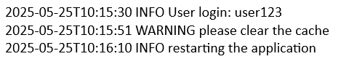
Milestone #3
Input:
M3_LogFile1.txt
M3_LogFile2.txt
Output:
Generate the below output file.
Step 1 – M3_Output.txt - Find the commands which can be applied to M3_LogFile1.txt to generate the M3_LogFile2.txt.
Output Format for M3_Output.txt:
REPLACE 32 “ERROR System restart Scheduled”
INSERT “2025-05-25T10:15:51 WARN please clear the cache” DELETE 12
INSERT “2025-05-25T10:16:10 INFO restarting the application”

Slide 8
Thank you

